Slide 1

Financial Risk Management
Spring 2016
Dr. Ehud Peleg
Stress Testing

Slide 2
Stress Testing Agenda
Stress Testing vs. Modeling
Scenario Analysis and Multiple Variable Stress
Top-down macro stress testing
Macro models
Satellite Models
CCAR / DFAST
Reverse Stress Testing

Slide 3
Disadvantages of VaR
Backward looking
Does not give insight into bad scenarios and to possible mitigation plans
Makes restrictive assumptions about underlying variables
Difficult to communicate to management

Slide 4
Individual vs. Several Variables
Stress individual variables (Scenario Analysis)
Better assessment of specific risk
Easy to use and control as a risk management limit
Allows more freedom in stress
Scenarios where several variables change
More realistic as variables are correlated
Tells a story and lends itself to a mitigation plan
But, limits the extremity each variable takes

Slide 5
Stress Testing
Key Questions
How do we generate the scenarios?
How do we evaluate the scenarios’ effect on our portfolio?
What do we do with the results?

Slide 6
Typical Stress Testing Framework
Stress Event – High level story (e.g. Subprime Crisis, Euro Crisis)
Macroeconomic Model - Links event to macroeconomic variables (e.g. GDP, interest rates, FX rates)
“Satellite” models - Link macroeconomic variables to their effects on banks’ assets (e.g. credit losses, MTM losses)
Impact on Firm/Portfolio – (e.g. earnings, capital, liquidity)
Adapted from Foglia(2009) – Stress Testing Credit Risk: A Survey of Authorities Approaches

Slide 7
Generating Scenarios
Choose particular days when there were big market movements and stress all variables by the amount they moved on those days
Form a stress testing committee of senior management and ask it to generate the scenarios
Regulatory requirements
Extreme shocks in Macro models

Slide 8
Regulatory Stress Tests
Comprehensive Capital Analysis and Review (CCAR).
Dodd Frank Act Stress Tests (DFAST)
Annual tests performed by the Fed and by the Banks (BHCs) themselves
About 30 banks with assets greater than $50B
Financial institutions submit capital plans that include projection of revenues, losses and balance sheet levels, as well as payout plans.
The Fed can approve the plan, or object from quantitative or qualitative reasons.

Slide 9
CCAR Scenarios for 2015
Three scenarios: baseline, adverse, severely-adverse
Quarterly scenarios: 2014:Q4-2017:Q4
28 macro variables: domestic and international
Economic activity: GDP, unemployment, disposable personal income, CPI
Asset Prices: house prices, stock market, VIX, commercial real estate prices
Interest Rates: 3mo, 5yr, 10yr treasury, 10-yr BBB, prime, 30yr mortgage
International: UK, Euro area, Asia, Japan

Slide 10
Severely Adverse Scenario
Substantial weakening in economic activity across all countries
Significant reversal of recent improvements in US housing market
Flight-to-safety capital flows towards US cause depreciation of other currencies
Recessions in Euro, UK and Japan, which are slow to recover
Below-trend growth in developing Asia

Slide 11
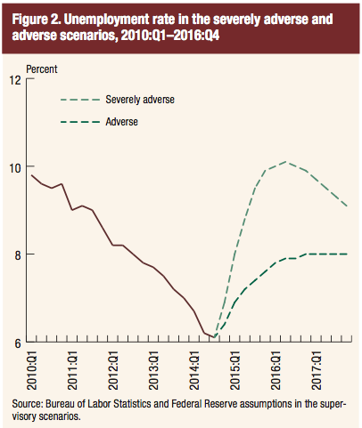
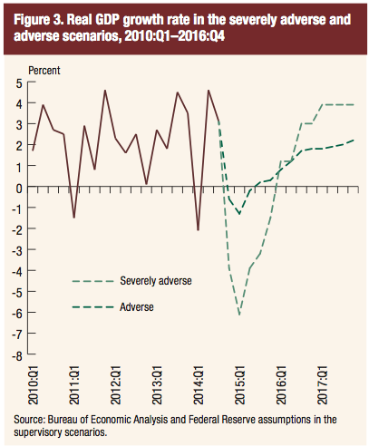
CCAR 2015 – Macro Variables in Scenarios

Slide 12
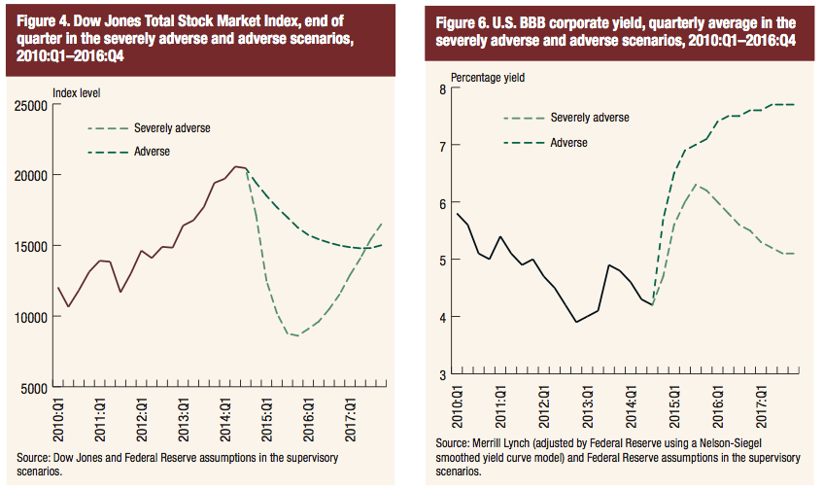
CCAR 2015 – Market Variables in Scenarios
60% drop

Slide 13
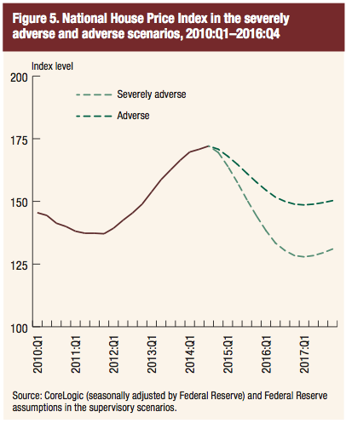
CCAR 2015 – Market Variables in Scenarios
VIX reaches 79 within one quarter of stress
Commercial real estate prices decline by 35%
Yield on 10-year Treasuries declines to 1%
25% drop

Slide 14
CCAR-Additional Shocks
6 BHCs are subject to another severe global market shock to their trading portfolio:
Shift in sovereign yield curves
Shocks to corporate and emerging market spreads
A severe Euro crisis
Increased risk aversion across markets
Instantaneous as opposed to the “main” evolving scenarios
8 BHCs are subject to an additional Counterparty Default Scenario

Slide 15
Satellite Models
How does the scenario affect the bank’s results?
Top-down approach – Macro-based regression models
Used by regulators. Foglia (2009) documents many variations.
LHS: default rate or losses; RHS: Macroeconomic factors
Bottom-up approach – Considers effects of macro variables on specific loans/securities or well-defined portfolios
Commonly used by banks

Slide 17
Applications for Stress Test Results
Solvency Tests
Verify that institution has enough capital to cover losses
Under CCAR BHCs have to show that they are well-capitalized (Tier 1 common ratio above 5%) even in stress-scenarios
Liquidity Tests
Verify that bank has enough liquid assets and stable funds to withstand intensive withdrawal of funds
Decision-making – Inform return vs. risk analysis
Risk appetite – Define limits to cap losses on a portfolio

Slide 18
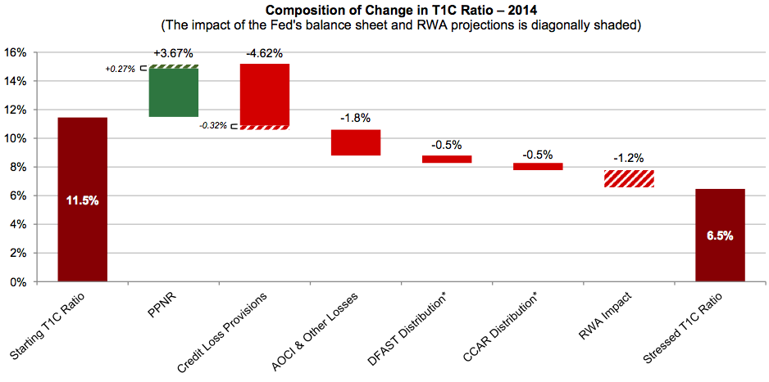
Effect on Capital Ratios
“Stress testing: A look into the Fed’s black box” (pwc, 2014)

Slide 19
Reverse Stress Testing
First we assume that there is a large loss then we look for what is the story
Typically done as a qualitative exercise
We can also look for the worst scenarios in our VaR simulation and figure out to what macroeconomic scenario they relate
Can be a useful input to the stress testing committee.

Slide 20
Thanks

